Slide 1

16 bit APProximate Wallace tree multiplier
- Tanay Patnaik
Project

Slide 2
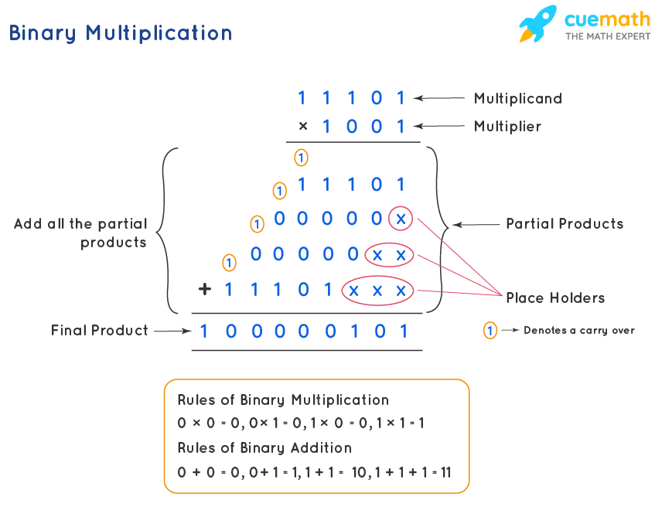
Digital multiplication is a fundamental operation in many applications.
Efficient multiplication is crucial for performance in digital systems.
The Wallace Tree Multiplier provides a method for high-speed multiplication by reducing the number of addition stages.
Binary Multiplication

Slide 3
Basic Concepts
Multiplication and Wallace tree
Digital Multiplication involves generating and summing partial products.
Techniques like the Wallace Tree are used to reduce the number of addition stages, improving speed.
The Wallace Tree reduces partial products by grouping them into sets.
Each set is reduced using half adders and full adders (compressors) until only two rows remain.
These two rows are then summed using a fast adder.

Slide 4
Steps of WALLACE TREE ADDITION
Partial Product Generation: Each bit of the multiplier is ANDed with each bit of the multiplicand.
Reduction: Partial products are grouped and reduced using adders.
Final Addition: The remaining two rows of partial products are summed.

Slide 5
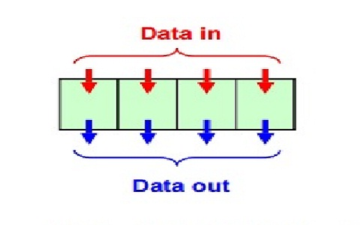
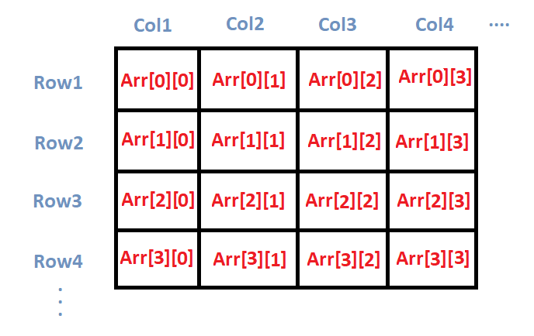
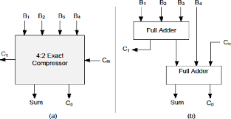
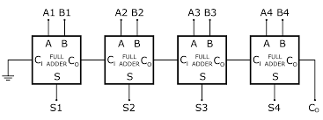
Components of the architecture
N-bit PIPO - Wallace tree multiplier - Storage
Input : The 16-bit or less numbers and the maximum number of bits as a parameter N when the load is HIGH are given in to the hardware in a single clock cycle.
Wallace tree multiplication : Each input is parallely multiplied and stored in an array that assumes Wallace tree configuration (shaped like inverted arrowhead).
Compression : The Wallace tree’s columns are compressed into 2 individual bits.
Final Addition : The compressed bits are now added to be stored in the final output register.

Slide 6
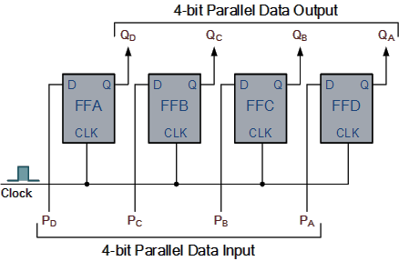
1-16 bit PIPO register
Parameterised Register
Parallel In - Parallel Out register is a register that is a sequential circuit make from simultaneous D-FlipFlops.
It uses 1 clock cycle to insert a data bit and it is available to the output. Hence consuming only one clock cycle.
We can make this a variable register by parametrising the maximum number of bits of either of multiplicand or multiplier.

Slide 7
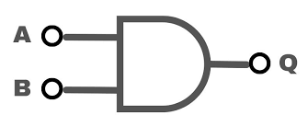
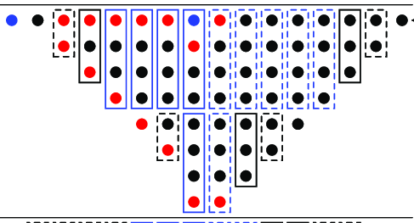
Parallel MULTIPLIER
An array of and gates
In order to create partial products, we make an AND operation between bits. So for maximum of n number of bits the number of partial products will be n²
These partial products are arranged in a Wallace tree configuration. Making it easier for us to apply the architecture.
This can be made in a wire to be able to achieve the architecture but also not cost extra time or hardware.
AND Gate
Wallace Tree

Slide 8
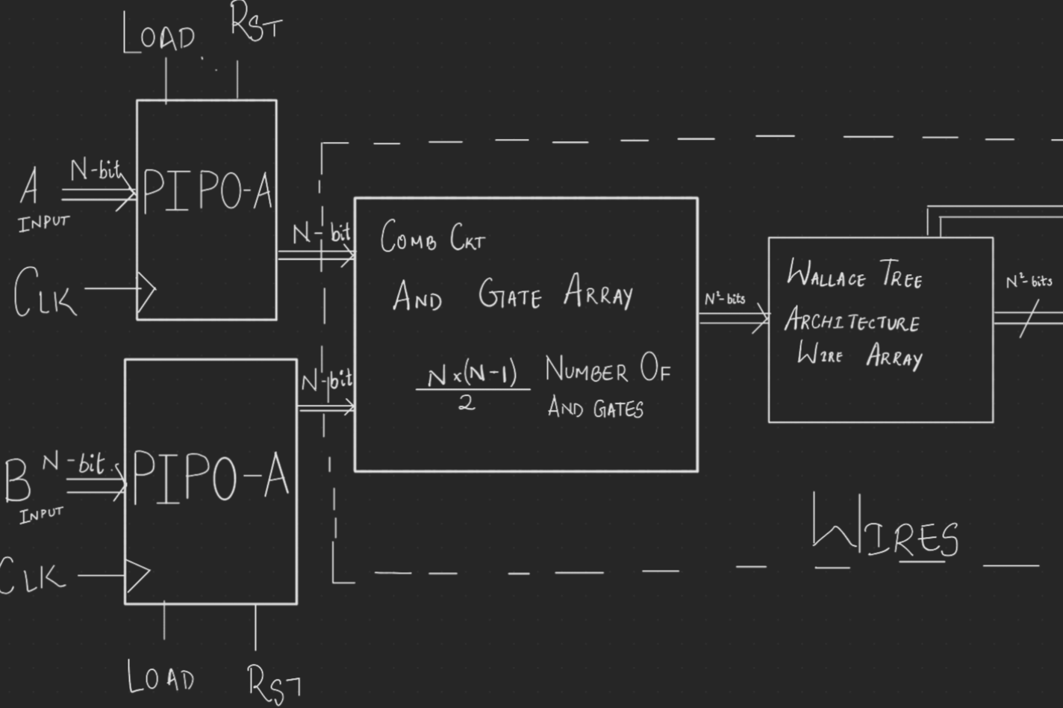
Architecture of the parallel Multiplier
Diagram based explanation
The following images gives us a clear image of the inputs, outputs and the working. The input can be given. In only when the LOAD inputs is HIGH(1). The RST pin clears the whole machine and sets it to 0.
The PIPO registers take in N-Bit numbers as inputs in 1 clock cycle.
The AND gates produce the partial products of the 2 numbers.
Which then is arranged in Wallace tree configuration with the help of wires instead of a register.
There are N^2 outputs and done is a wire that is also given out as output for future use.

Slide 9
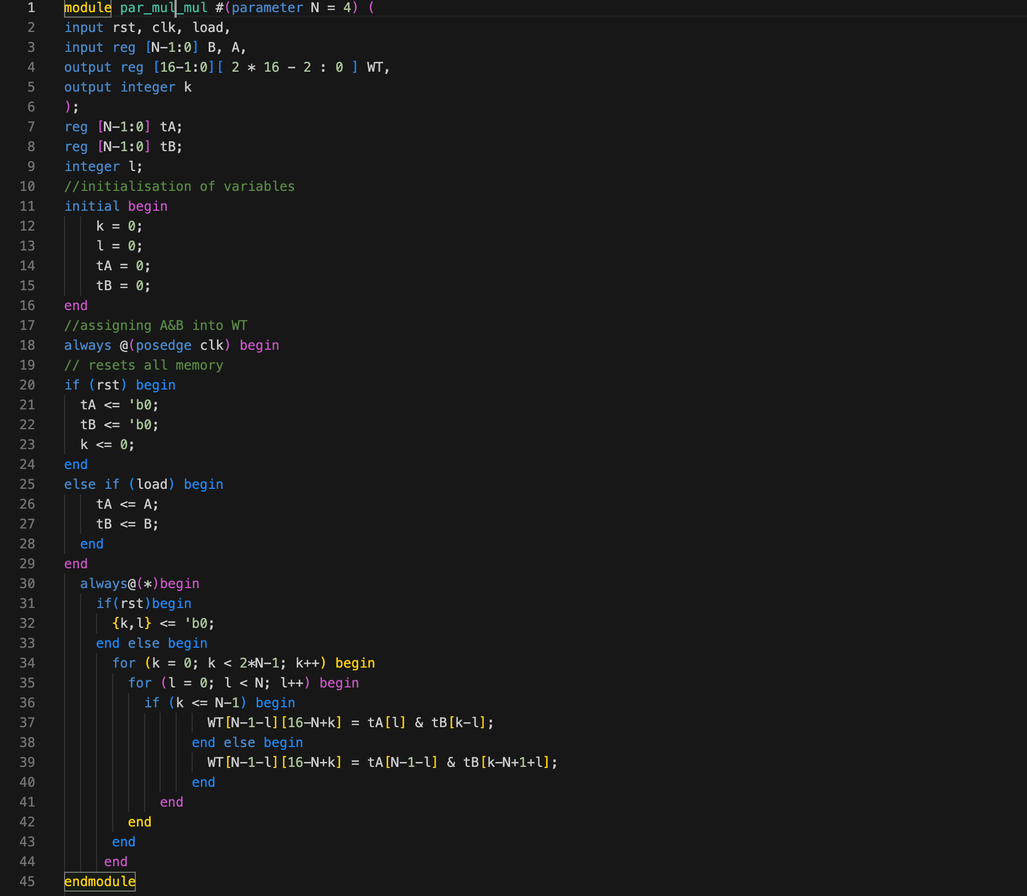
CODE BLOCK

Slide 10
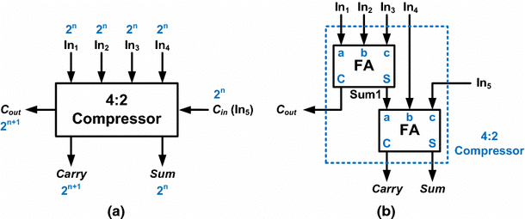
Compressors
Compressing multiple bits into 2
As the name suggests, compressors compress multiple bits into a single bit but giving out carries to the next column/set of compressors.
They are comprised of mainly full or half adders which are interconnected to form one bit and generate carry to the next compressors.
There are multiple compressors used in the hardware so as to be able to compress upto 15 bits.

Slide 11

Compressors
What does is eventually produce
It eventually, through addition, produces 2 bits that can be simply added.
Instead of a cumbersome addition right from the start, it gives a simplified configuration for addition.
This configuration can be simply put into Full Adders to produce a final output.
The compressors simplify the partial products in a manner as show in the following picture.

Slide 12
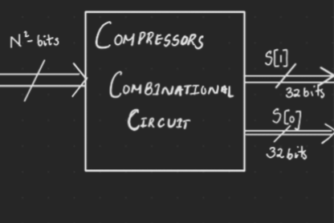
COMPRESSOR
AS A PART OF The architecture
It takes the output from the Wallace tree as a wires, takes them as input and compresses into a wire array of compressed partial products.
It gives an output of 2 * N + 1 number of bits in each row.
It has a reset input that sets it to 0 when turned HIGH.

Slide 13
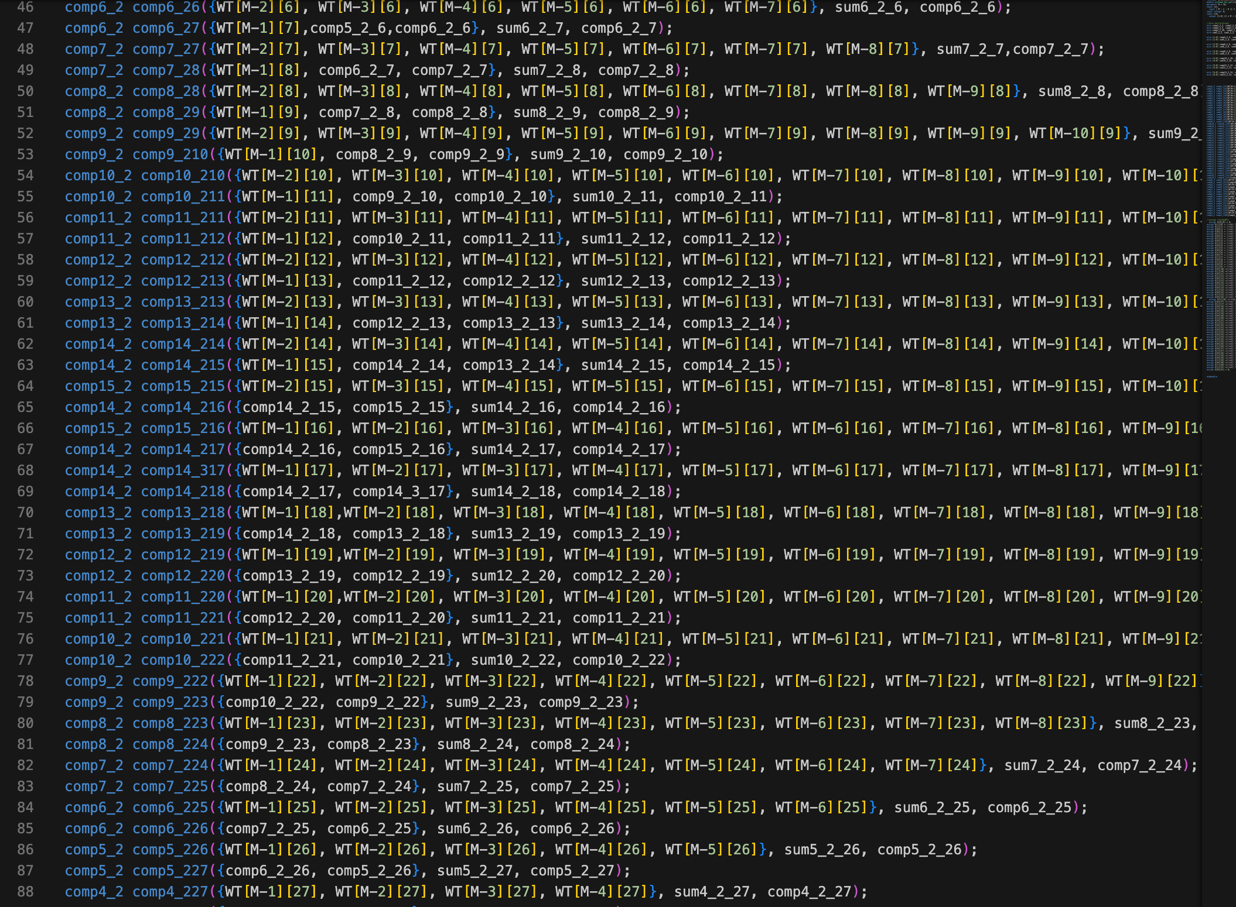
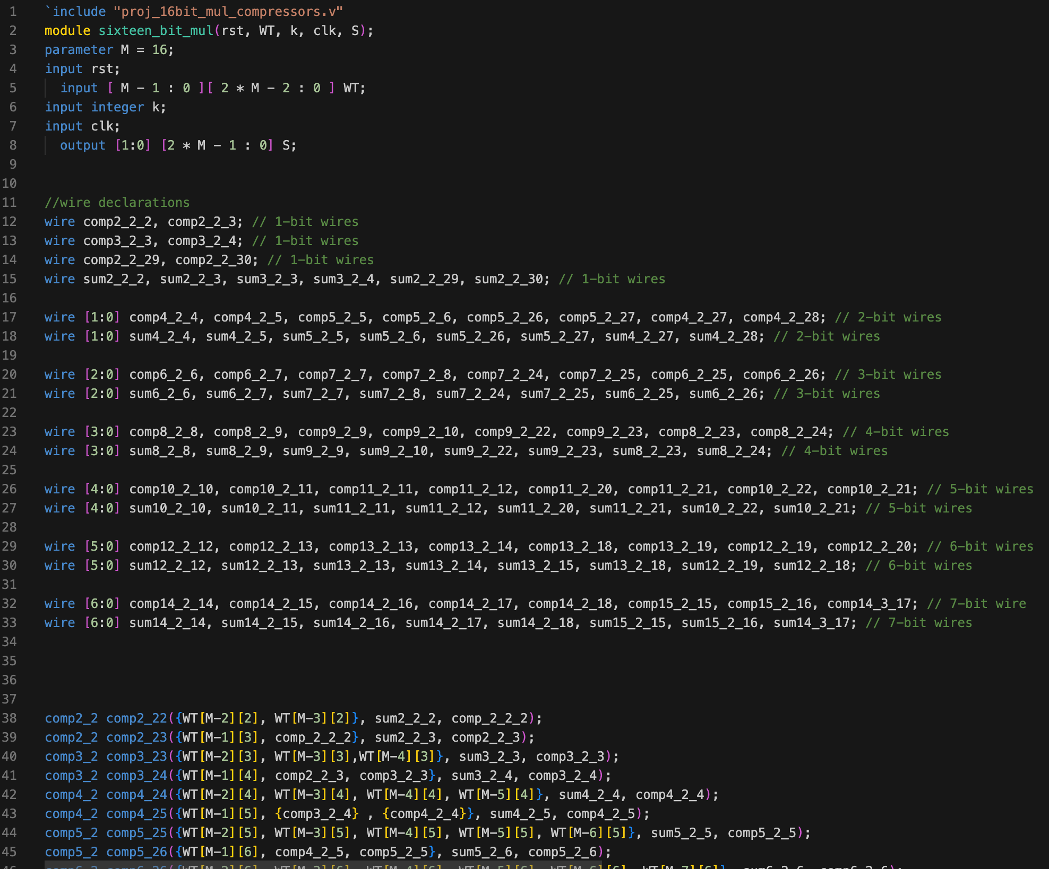
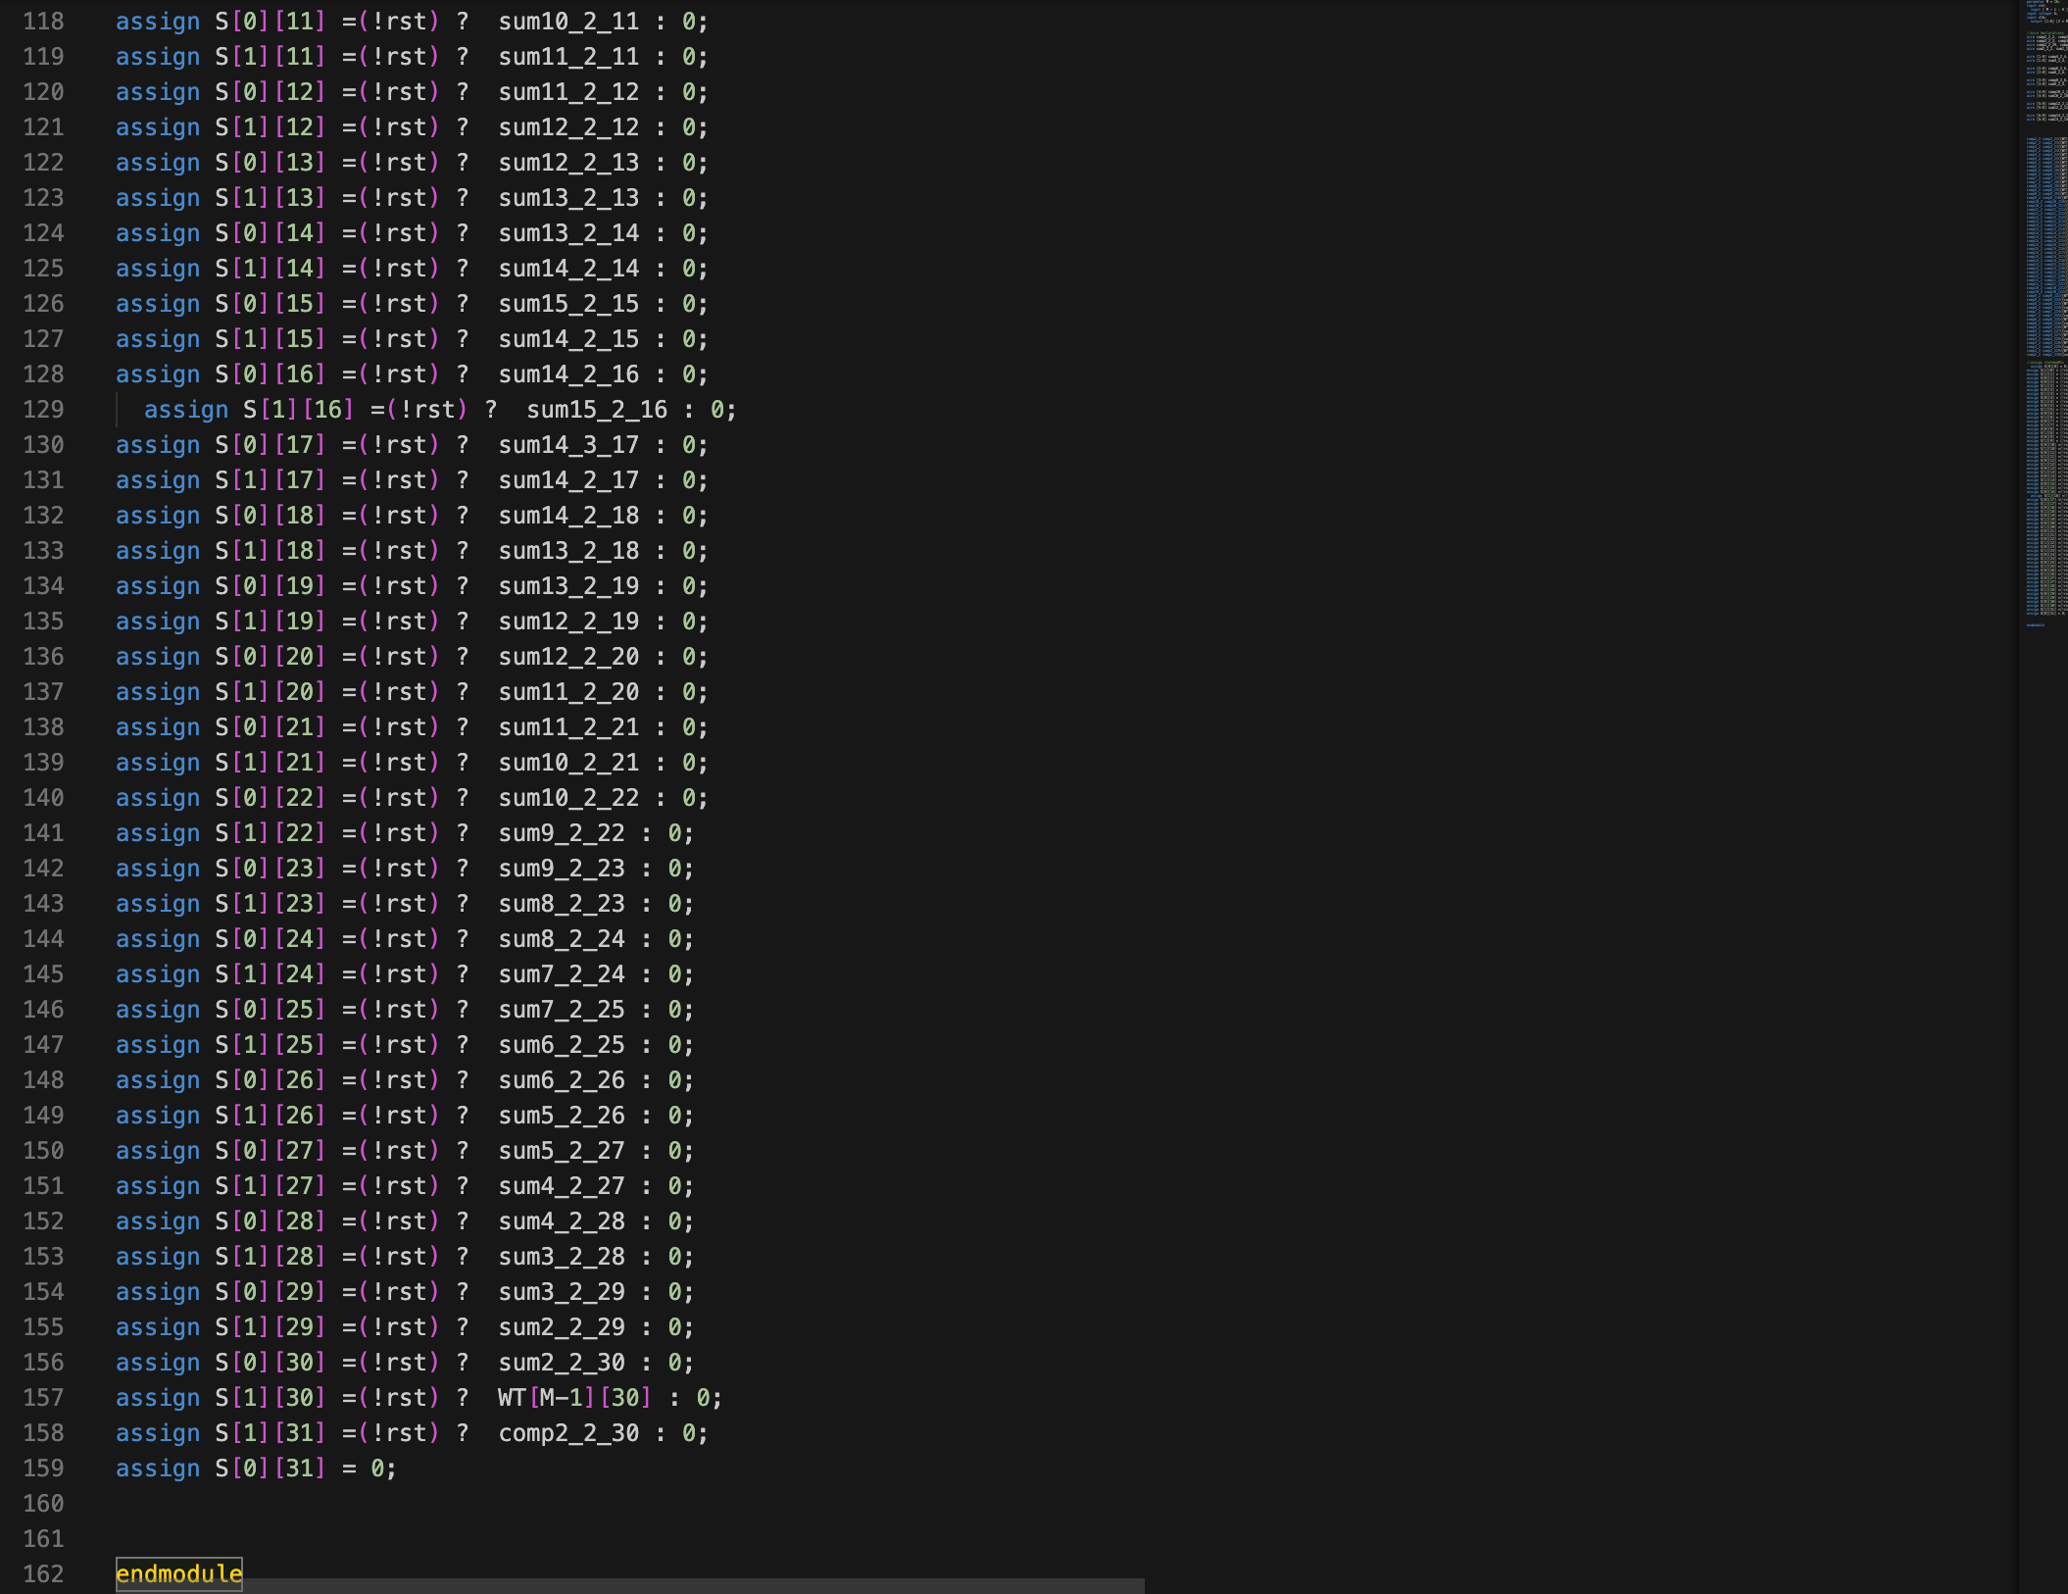
Compressors as a part of architecture

Slide 14
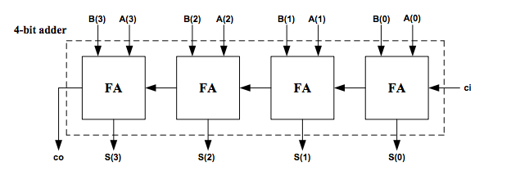
Full-Adder Array and OUTPUT PIPO
Addition of compressed Partial products
This is an array of full adders that simply adds the 2 compressed partial products to give out the necessary output.
It is comprised of 2 phases where in :
It gives out the sum bit.
It then stores then in the output PIPO register.

Slide 15
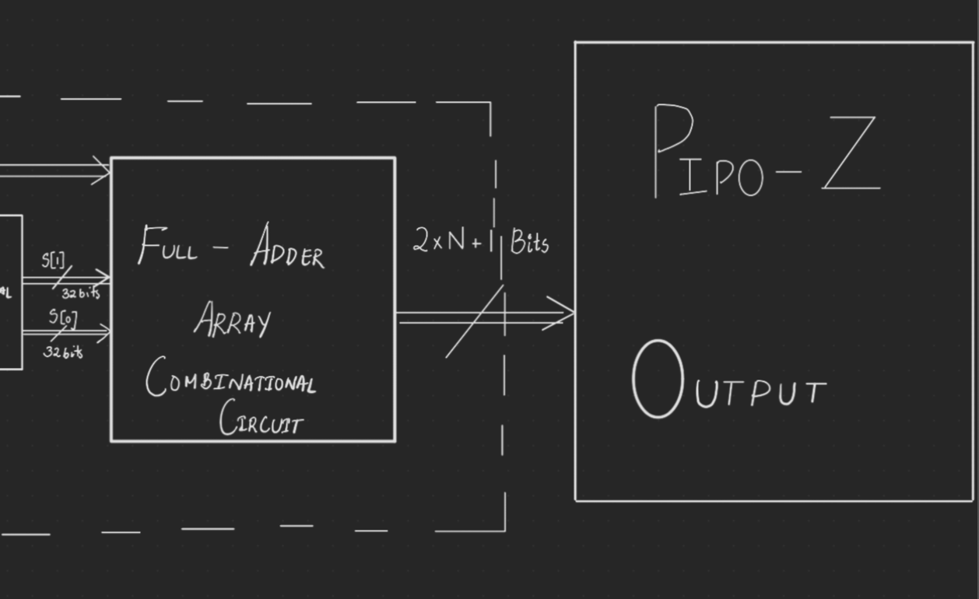
FULL-ADDER and OUTPUT PIPO
As a part of architecture
This block takes two 32-bit inputs puts it into the two inputs of a full adder. The wire done is taken as input in order to ensure that the outputs go into the register only when the remaining operations are already done.
This consumes one clock cycle to put the outputs into a register.
This also has a reset pin which on turning HIGH clears the inputs and outputs to 0.
This has an output of 2 * N + 1 bits stored in a PIPO register.

Slide 16
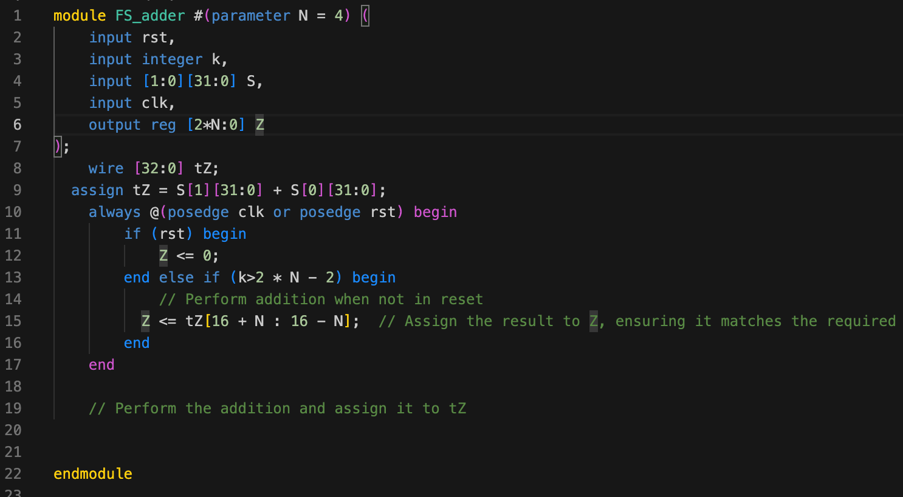
Code block

Slide 17
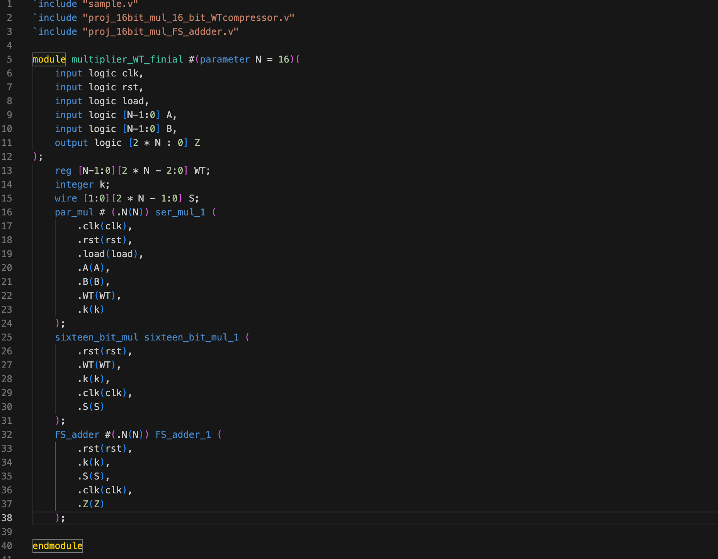
Top MODULE
Instantiating all the modules
The top module calls on all the existing modules in order to bring the whole circuit together.
All that we have seen until now will be instantiated and used in order to execute the whole mechanism as planned/stated.
It has inputs clk, rst, A, B, N and load.
The outputs will be Z.

Slide 18
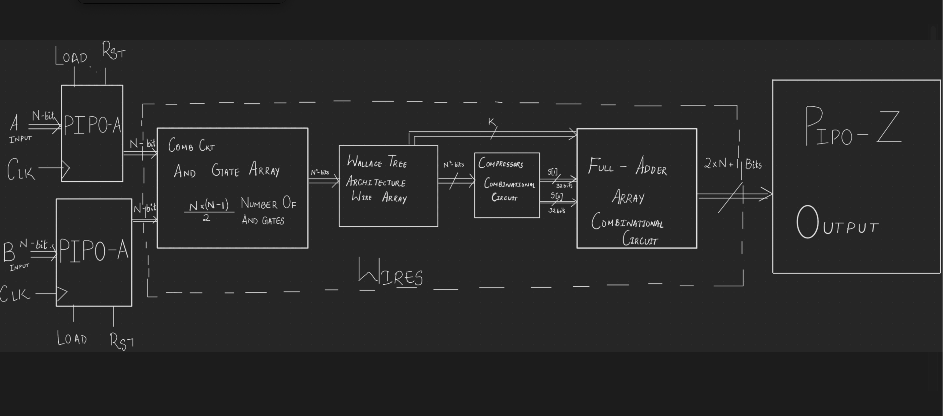
The complete architecture

Slide 19
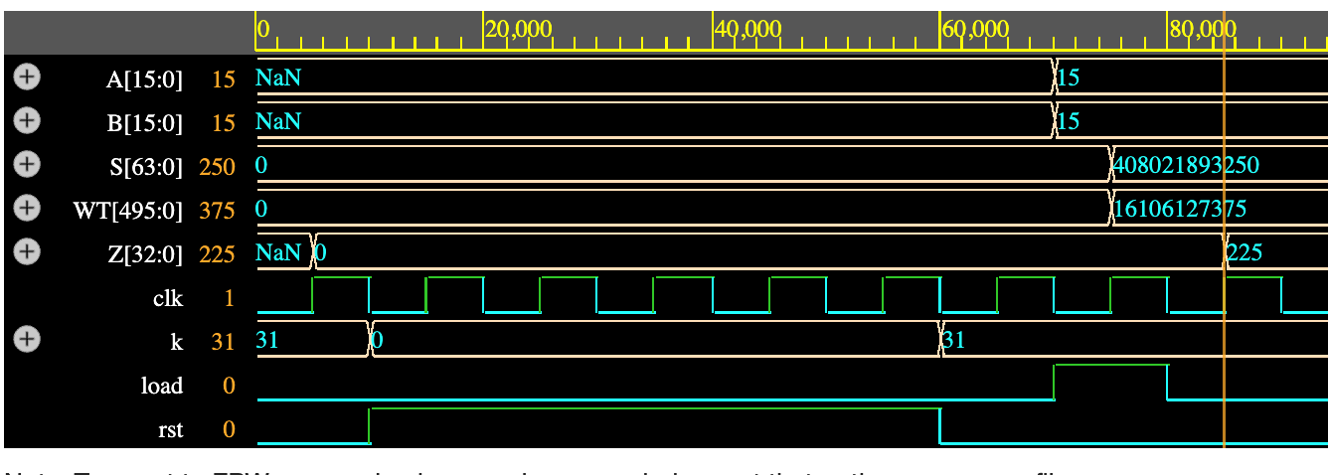
The timing diagram
Test case : N = 4, A = 1111(15), B = 1111(15) , Z = 1110001(225)

Slide 20
APPROXIMATE WALLAce tree multiplier
For error tolerable systems
Simplifies the Wallace tree stages by reducing the number of levels or by approximating the addition process within each level using approximate carry-save adders (CSAs).
This is done by replacing the Sum of a full adder from XOR gate to suitable logic using AND and/or OR gates.
This is quite close to the required product but there is some or the other deviation causing changes to the final product.
Hence we find the standard deviation, mean deviation and max error in the product.

Slide 21

Table 1
Approximated to | Error | Mean Error | Variance | Std Deviation | Max Error
15th position | 12236923888 | 122369.238880 | 4883835860.72885 | 69884.446487 | 308072
14th position | 5618589400 | 56185.894000 | 922754651.763164 | 30376.876926 | 144232
13th position | 2364531896 | 23645.318960 | 201281622.381945 | 14187.375458 | 69768
12th position | 1368338584.000000 | 13683.385840 | 48382324.074647 | 6955.740369 | 34536
11th position | 569392288 | 5693.922880 | 9529730.773573 | 3087.026202 | 15496
10th position | 277994392 | 2779.943920 | 2134714.645175 | 1461.066270 | 6504
9th position | 109724192 | 1097.241920 | 372194.294435 | 610.077286 | 2760
8th position | 58981192 | 589.811920 | 122782.611346 | 350.403498 | 1464
7th position | 25364264 | 253.642640 | 19865.451494 | 140.944853 | 552
6th position | 12818944 | 128.189440 | 6230.135632 | 78.931208 | 296
5th position | 5825016 | 58.250160 | 1084.934220 | 32.938340 | 104
4th position | 2075000 | 20.75 | 223.4375 | 14.947826 | 40
3rd position | 550000 | 5.5 | 15.75 | 3.968627 | 12
2nd position | 50000 | 0.5 | 1.75 | 1.322876 | 4
1st position | 0 | 0 | 0 | 0 | 0

Slide 22
On implementing approximation on various columns of Wallace Tree

Slide 23
Timing diagram
Explaining the timing diagram
The whole process consumes 2 clock cycles.
Each clock cycle is used for the input to the PIPO register.
The whole clock cycle should at least be equal to the delay caused by the combinational logic.
The concepts of Static Timing Analysis(STA) can be implemented in order to implement the practical circuit (for Setup and Hold time).

